Slide 1
Twitter Political Parties
End-to-End Data Pipeline

Slide 2
Azure Modern Data Stack Project
• Built a production-grade pipeline on real web-scraped Twitter data set.
• Incremental, monitored, CI/CD-enabled, star-schema ready

Slide 3
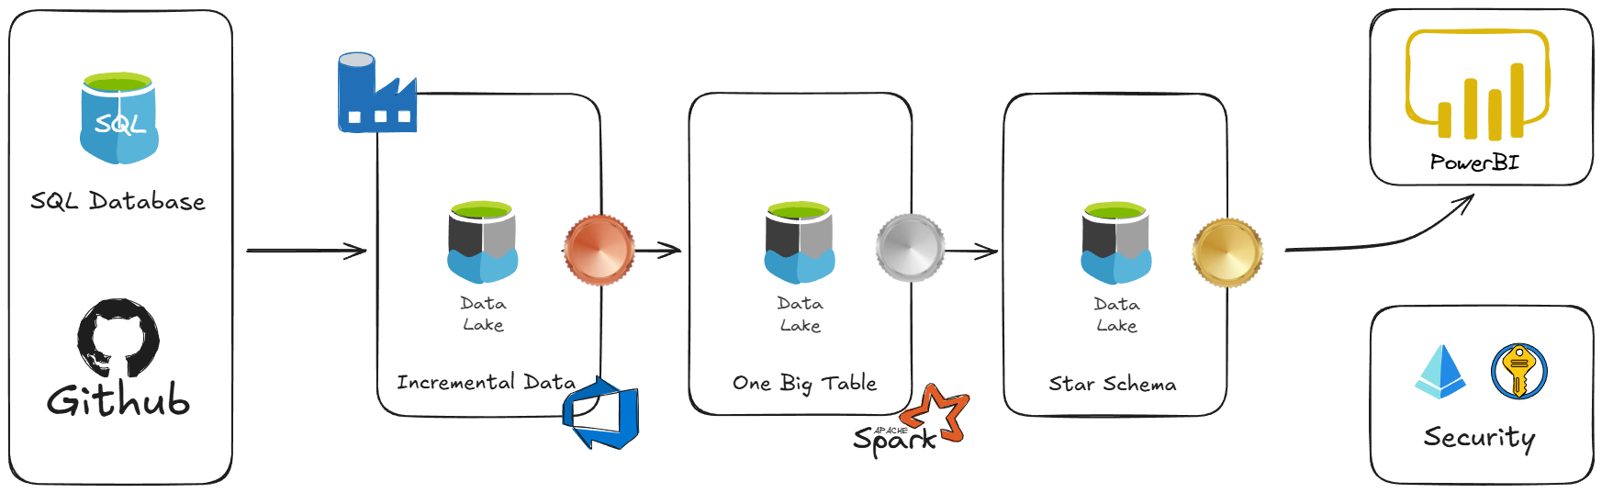
High-Level Architecture Medallion Architecture
(Bronze → Silver → Gold)
• Web – scraped data → GitHub → SQL DB → ADF → ADLS Gen2 → Databricks → Power BI

Slide 4
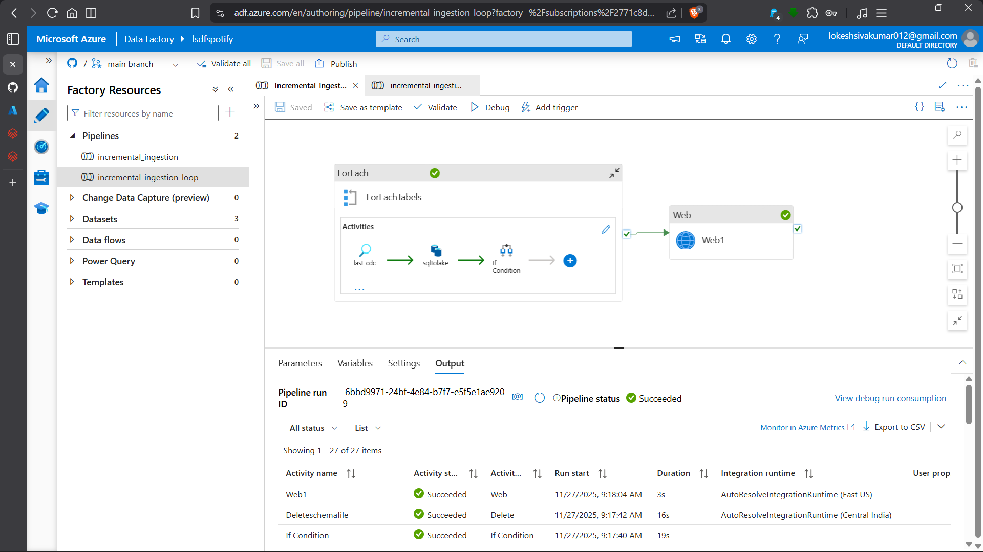
Ingestion – Azure Data Factory
• Fully incremental with CDC watermark & back-date support. • Parameterised + ForEach loop.
• Git-integrated CI/CD → automatic deploy to prod

Slide 5
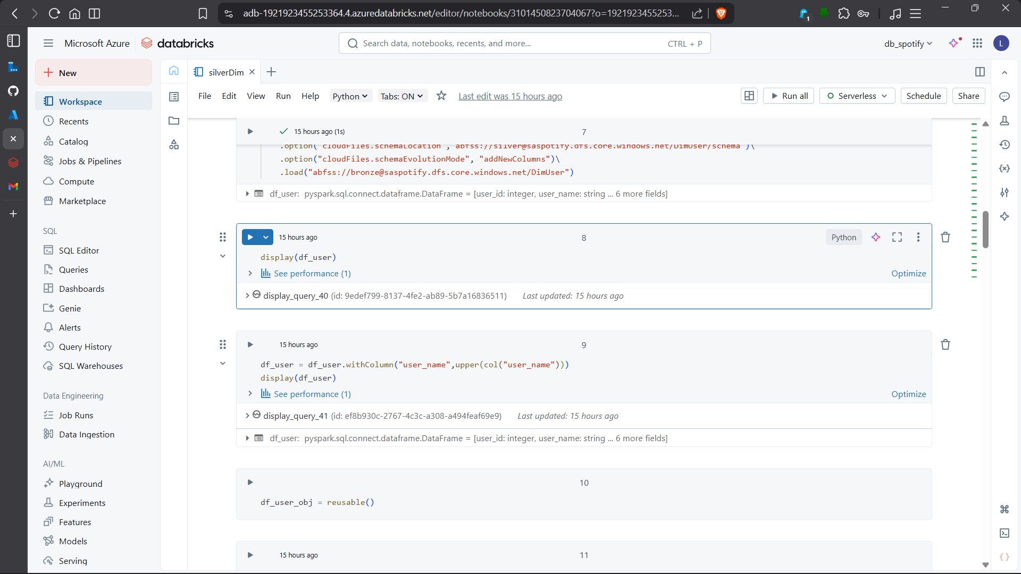
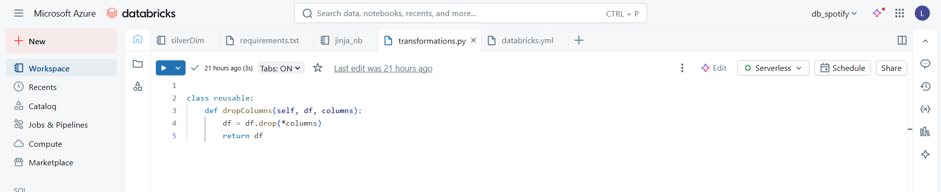
Transformation – Databricks
• AutoLoader + Spark Streaming
• Schema validation on ingest
• Created date columns, mapped parties using JSON lookup
• Saved as Delta Tables

Slide 6
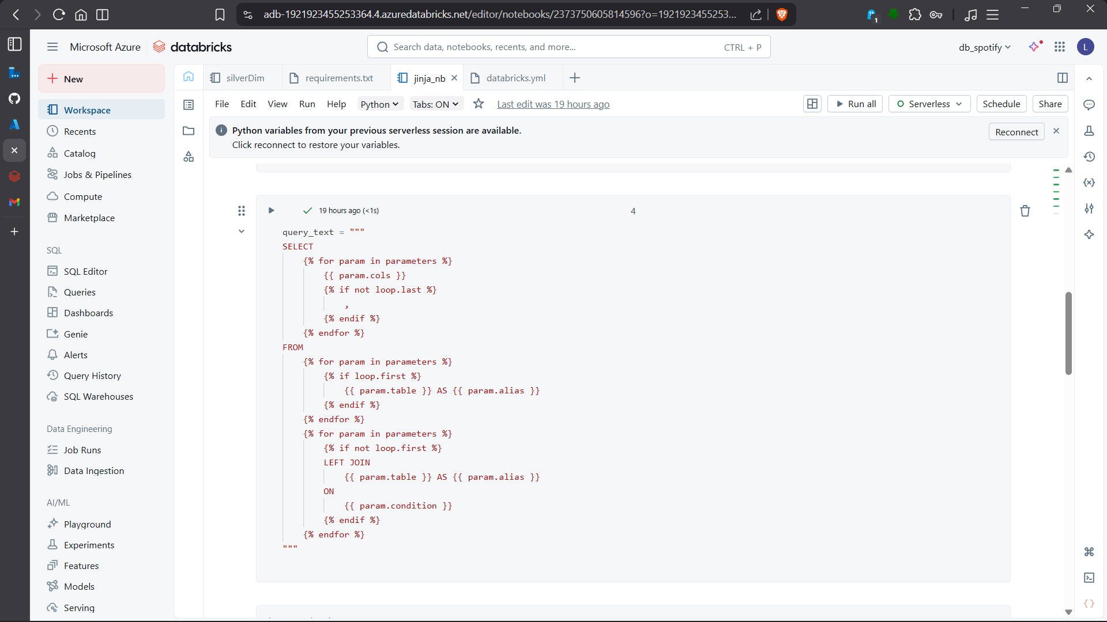
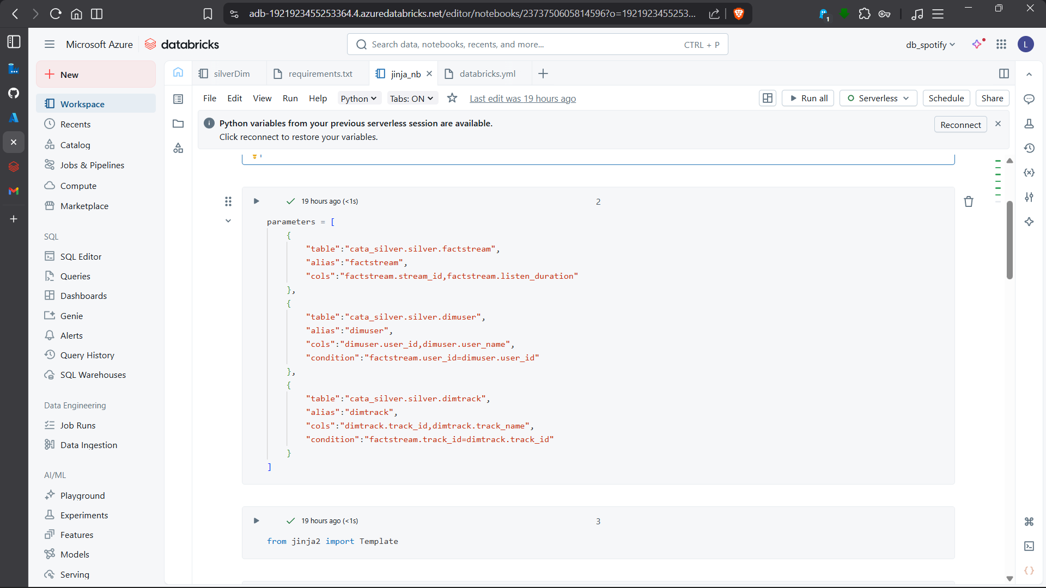
Gold Layer – Star Schema + SCD Type 2
• Delta Live Tables (DLT) for automated ETL
• Dimensions: DimDate, DimDistrict, DimParty, DimUser (with SCD-2)
• FactTweets table

Slide 7
Challenges I Solved
• Web-scraping blocks → rotating headers
• Inconsistent data → standardised with PySpark
• Schema evolution → Delta Lake versioning
• No monitoring → Git CI/CD + alerts

Slide 8
What I Gained (Ready for Your Team!)
Hands-on production experience with:
• Azure Data Factory
(incremental + CI/CD)
• Databricks + Delta Live Tables + SCD
• Star-schema modeling
• End-to-end ownership
from raw → insights
I can build and maintain scalable pipelines from Day 1
Any questions?
😊
Thank you!

